Slide 1





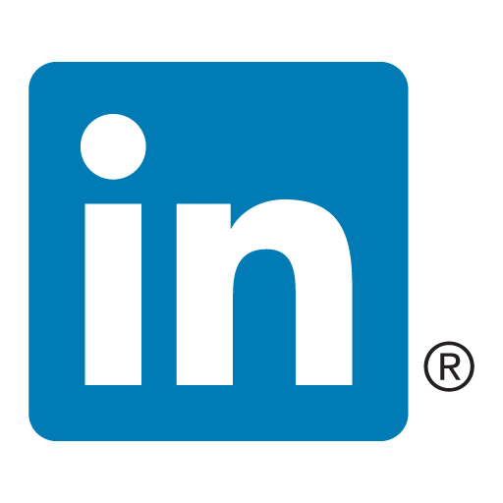
Lightning Talk Cloud && Data centers && Irish Tech HUB
Tünde Csapó
Green Fox Academy / Fulvipes / Secret
tundecsapo
Tunde Csapo

Slide 2
< AGENDA >
Data centers
Benefits of using cloud
Irish tech HUB

Slide 3
< data center>
“A data is a facility composed of networked computers and storage that businesses or other organizations use to organize, process, store and disseminate large amounts of data. A business typically relies heavily upon the applications, services and data contained within a data center, making it a focal point and critical asset for everyday operations.”

Slide 4
< data center elements>
IT equipments:
servers,
storage subsystems,
networking switches,
routers,
firewalls,
cabling,
physical racks
Infrastructure:
power distribution,
supplemental power subsystems,
electrical switching,
uninterruptable power supplies,
backup generators,
ventilation,
data center cooling systems,
network carrier (telco) connectivity

Slide 5
< data center>
Facility – the location and the usable space, that is available for IT equipment. Providing round-the-clock access to information makes data centers some of the most energy-consuming facilities in the world. A high emphasis is placed on design to optimize white space and environmental control to keep equipment within manufacturer-specified temperature/humidity range.
Support infrastructure – equipment contributing to securely sustaining the highest level of availability possible. The Uptime Institute defined four tiers data centers can fall under, with availability ranging from 99.671% to 99.995%. Some components for supporting infrastructure include:
Uninterruptible Power Sources (UPS) – battery banks, generators and redundant power sources.
Environmental Control – computer room air conditioners (CRAC), heating, ventilation, and air conditioning (HVAC) systems, and exhaust systems.
Physical Security Systems – biometrics and video surveillance systems.
IT equipment – actual equipment for IT operations and storage of the organization’s data. This includes servers, storage hardware, cables and racks, as well as a variety of information security elements, such as firewalls.
Operations staff – to monitor operations and maintain IT and infrastructural equipment around the clock.

Slide 6
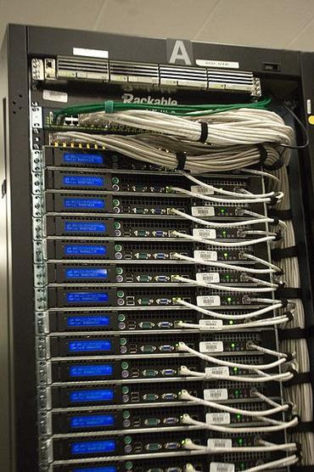
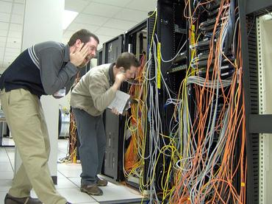
< data center>
Evolution of datacenters (due to cloud computing and virtualization)
10 critical elements of an efficient data center
1. Environmental controls (temperature, humidity fire suppression, air flow and power distribution)
seismic and meteorological stability, access to roads and airports,
2. Security
3. Accountability
4. Policies 6. Monitoring
7. Scalability
9. Organization
10. Documentation

Slide 7
Cost of Ownership
initial capital expenditures
ongoing expenses
Hardware
Networking and bandwidth expenditures
Cost of power (including redundant systems and their maintenance)
Cooling costs
Physical security
Ongoing maintenance

Slide 8
Other costs:
Software Investment
Resource Management
Utilization

Slide 9
regulatory compliant
access to additional functionality
Reduced Downtime
Advanced Security
Disaster Recovery
'Accident' Proof
scalability and mobility for growing your business

Slide 10
internet-facing or enterprise (or “internal”) data centers.

Slide 11
internet-facing or enterprise (or “internal”) data centers.
HYBRID CLOUD APPROACH
Benefits
Start Small and Expand as Needed
Expand Your Data Center Seamlessly and Transparently
creation of a dynamic environment that allows organizations to run workloads locally or in the cloud

Slide 12

< DATA CENTERS >

Slide 13
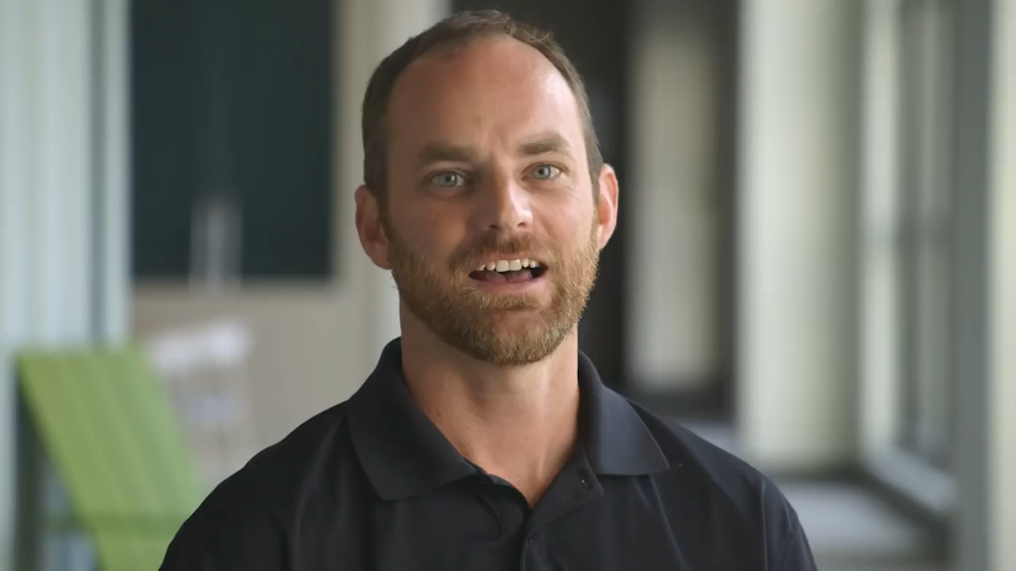
< DATA CENTERS >

Slide 14
virtualization to add a level of automation, user self-service and billing/chargeback to data center administration. The goal is to allow individual users to provision workloads and other computing resources on-demand, without IT administrative intervention.

Slide 15
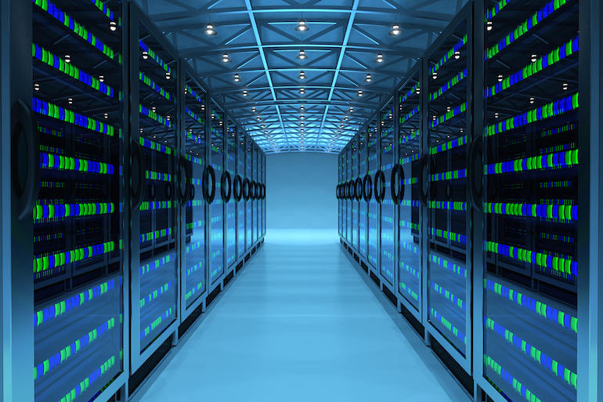
Cloud computing is a general term for the delivery of hosted services over the internet.
Cloud computing enables companies to consume a compute resource, such as a virtual machine (VM), storage or an application, as a utility -- just like electricity -- rather than having to build and maintain computing infrastructures in house
accessing computer, information technology (IT), and software applications through a network connection, often by accessing data centers using wide area networking (WAN) or Internet connectivity.

Slide 16
Cloud computing traces its origins back to the 1960s, when the computer industry recognized the potential benefits of delivering computing as a service or a utility. However, early computing lacked the connectivity and bandwidth needed to implement computing as a utility. It wasn't until the broad availability of internet bandwidth in the late 1990s that computing as a service became practical.
In the late 1990s, Salesforce offered one of the first commercially successful implementations of enterprise SaaS. This was followed closely by the arrival of AWS in 2002, offering a range of services, including storage and computation -- and now embracing databases, machine learning and other services. Today, Microsoft Azure, Google Cloud Platform and other providers have joined AWS in providing cloud-based services to individuals, small businesses and global enterprises.

Slide 17
< Advantages of Cloud Computing>
The three cloud implementation models are:
[ To comment on this story, visit Computerworld's Facebook page. ]
Private cloud: Created and run internally by an organization or purchased and stored within the organization and run by a third party
Hybrid cloud: Outsources some but not all elements either internally or externally
Public cloud: No physical infrastructure locally, all access to data and applications is external

Slide 18
< Advantages of Cloud Computing>
Cost savings
Security
Flexibility
Mobility
Insight
Increased collaboration

Slide 19
< Advantages of Cloud Computing>
Quality control
Disaster recovery
Loss prevention
Automatic software updates
Competitive edge
Sustainability

Slide 20
< Advantages of Cloud Computing>
https://www.salesforce.com/hub/technology/benefits-of-cloud/
http://www.information-age.com/top-10-benefits-cloud-computing-123467995/
https://www.levelcloud.net/why-levelcloud/cloud-education-center/advantages-and-disadvantages-of-cloud-computing/

Slide 21

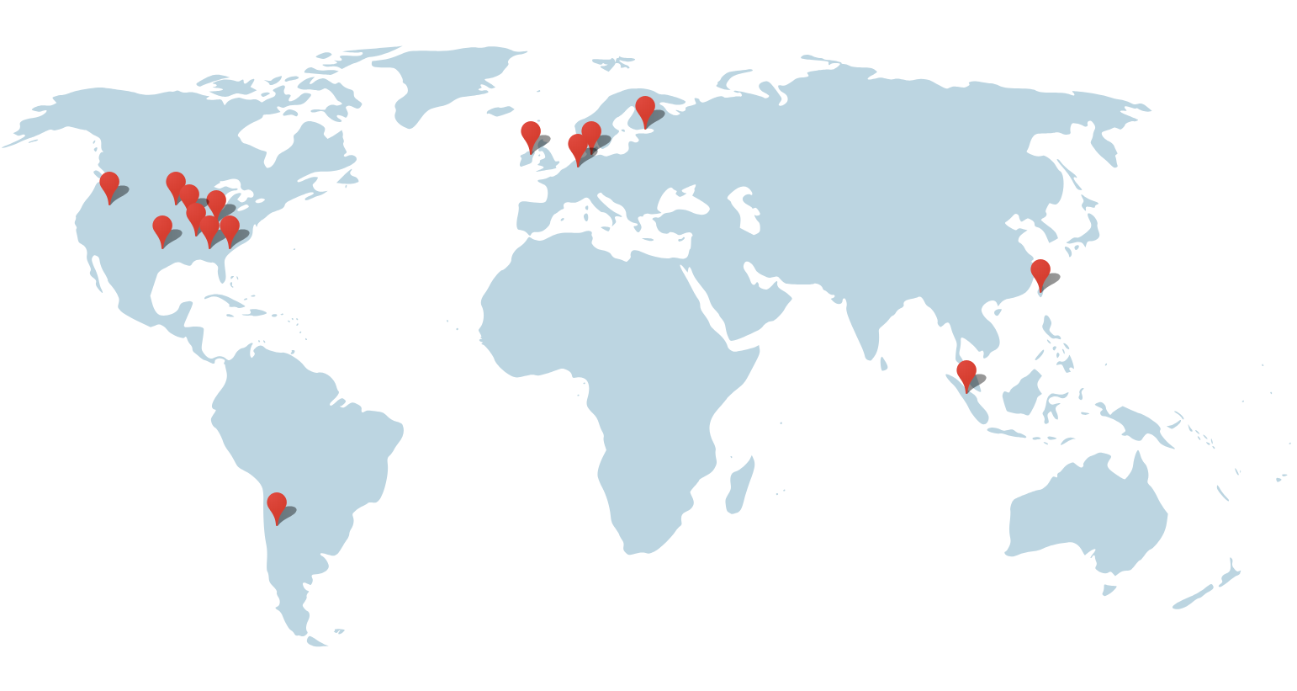
< DATA CENTERS >
15 main data centers
Americas
Berkeley County, South Carolina
Council Bluffs, Iowa
Douglas County, Georgia
Jackson County, Alabama
Lenoir, North Carolina
Mayes County, Oklahoma
Montgomery County, Tennessee
Quilicura, Chile
The Dalles, Oregon
Asia
Changhua County, Taiwan
Singapore
Europe
Dublin, Ireland
Eemshaven, Netherlands
Hamina, Finland
St Ghislain, Belgium

Slide 22
< DATA CENTERS in ireland >
5 reasons why Ireland is Europe’s data centre hub
The Irish economy
taxes
Ireland’s location
Educated workforce
Connectivity
Host in Ireland
https://www.siliconrepublic.com/enterprise/ireland-europe-data-centre-hub

Slide 23
< What is a tech hub?>
“A unique environment, a type of utopia where everything happens faster, people are smarter and meeting investors is easier. A geographical location that encourages people from different areas of the IT landscape to gather from web designers to digital marketers, developers to angel investors. It is getting the right people together in a close environment, where ideas are given the space to germinate and fantastic things will happen.”
A Tech hub is a common place where business ideas germinate and IT companies prosper, fostering the perfect blend of skills, education and a sense of community. They have the ability to boost creativity and collaboration

Slide 24
< Ireland data center & TECH HUB>
5 reasons why Ireland is Europe’s data centre hub
The Irish economy
low corporate taxes (12.5%) Ireland’s location
Foreign direct investment (FDI) has been Ireland’s primary market driver
flexible labour laws, the technology infrastructure and also the transparent regulation for companies, such as 25% R&D tax credit
Educated workforce
Connectivity
Host in Ireland
https://www.siliconrepublic.com/enterprise/ireland-europe-data-centre-hub

Slide 25
growing network of incubators
bodies like Enterprise Ireland and IDA Ireland provide permanent support to startups at all stages of development, through mentoring, research, and much more
Tech summits
skilled labour
Strong pool of highly skilled English-speaking workforce
-→ achieving diversity

Slide 26
excellent flight connectivity with both the US and the EU, the kindness of Irish people and the fact of being Europe´s youngest city (50% of population under the age of 35)
Brexit?!?!

Slide 27
< Ireland data center HUB>
U.S. companies with data centers in Ireland
Amazon and Microsoft both have facilities in Dublin, with Microsoft’s being one of the largest in Europe. Now, Apple is looking to build a €850 million data center in Athenry, outside Dublin.
Other factors favoring Ireland is that it has benefitted from investment by U.S. firms from the gaming, pharmaceuticals and content sectors making the country their European headquarters.
Renewable energy is also one reason for Ireland’s shine. EirGrid says potential data center power capacity could increase to 1,000 MW after 2019. Renewable energy—primarily from wind energy—is a key government priority and is targeting 40 percent by 2020

Slide 28
< Ireland data center HUB>
http://www.datacenterknowledge.com/europe/it-s-cool-it-s-well-wired-and-it-s-staying-eu
http://www.thejournal.ie/ireland-data-centres-3656728-Oct2017/
https://www.siliconrepublic.com/enterprise/data-centre-network-ireland

Slide 29
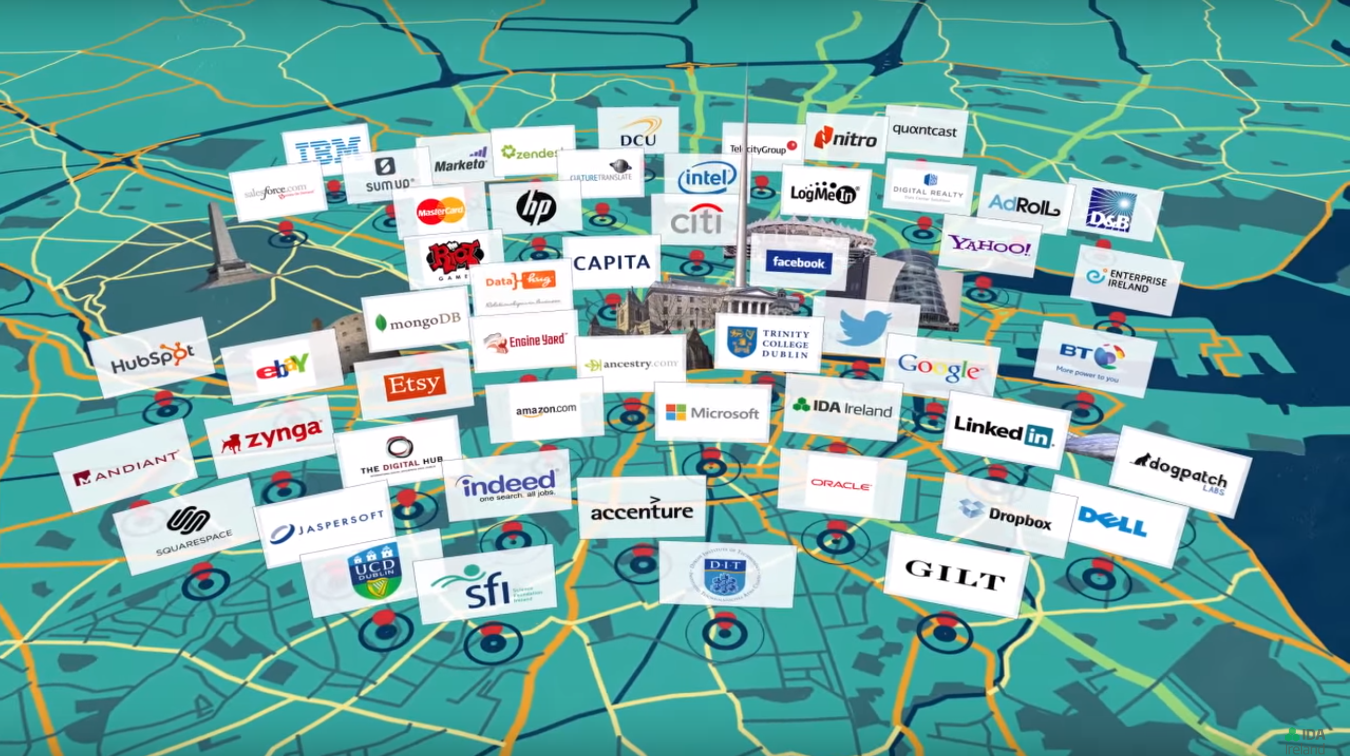
< Dublin’s Tech Hub>
Plain: ABCDEFGHIJKLMNOPQRSTUVWXYZ
Cipher: XYZABCDEFGHIJKLMNOPQRSTUVW
Plaintext: THE QUICK GREEN FOX JUMPS OVER THE LAZY DOG
Ciphertext: QEB NRFZH DOBBK CLU GRJMP LSBO QEB IXWV ALD

Slide 30
< DUBLIN’s tech hub>
Irish Tech Hub: more than low taxes
http://cloudnine.ie/dublin-as-an-emerging-tech-hub-really/
http://www.gedeth.com/blog/2017/12/20/irish-tech-hub/
https://www.siliconrepublic.com/careers/global-tech-hub-ireland
https://blog.newrelic.com/2017/03/17/dublin-ireland-european-technology-leader/

Slide 31


Slide 32

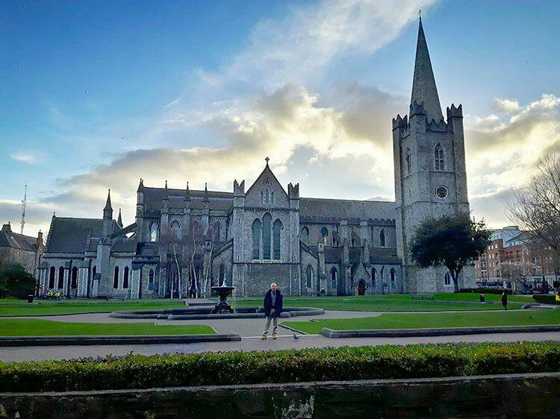
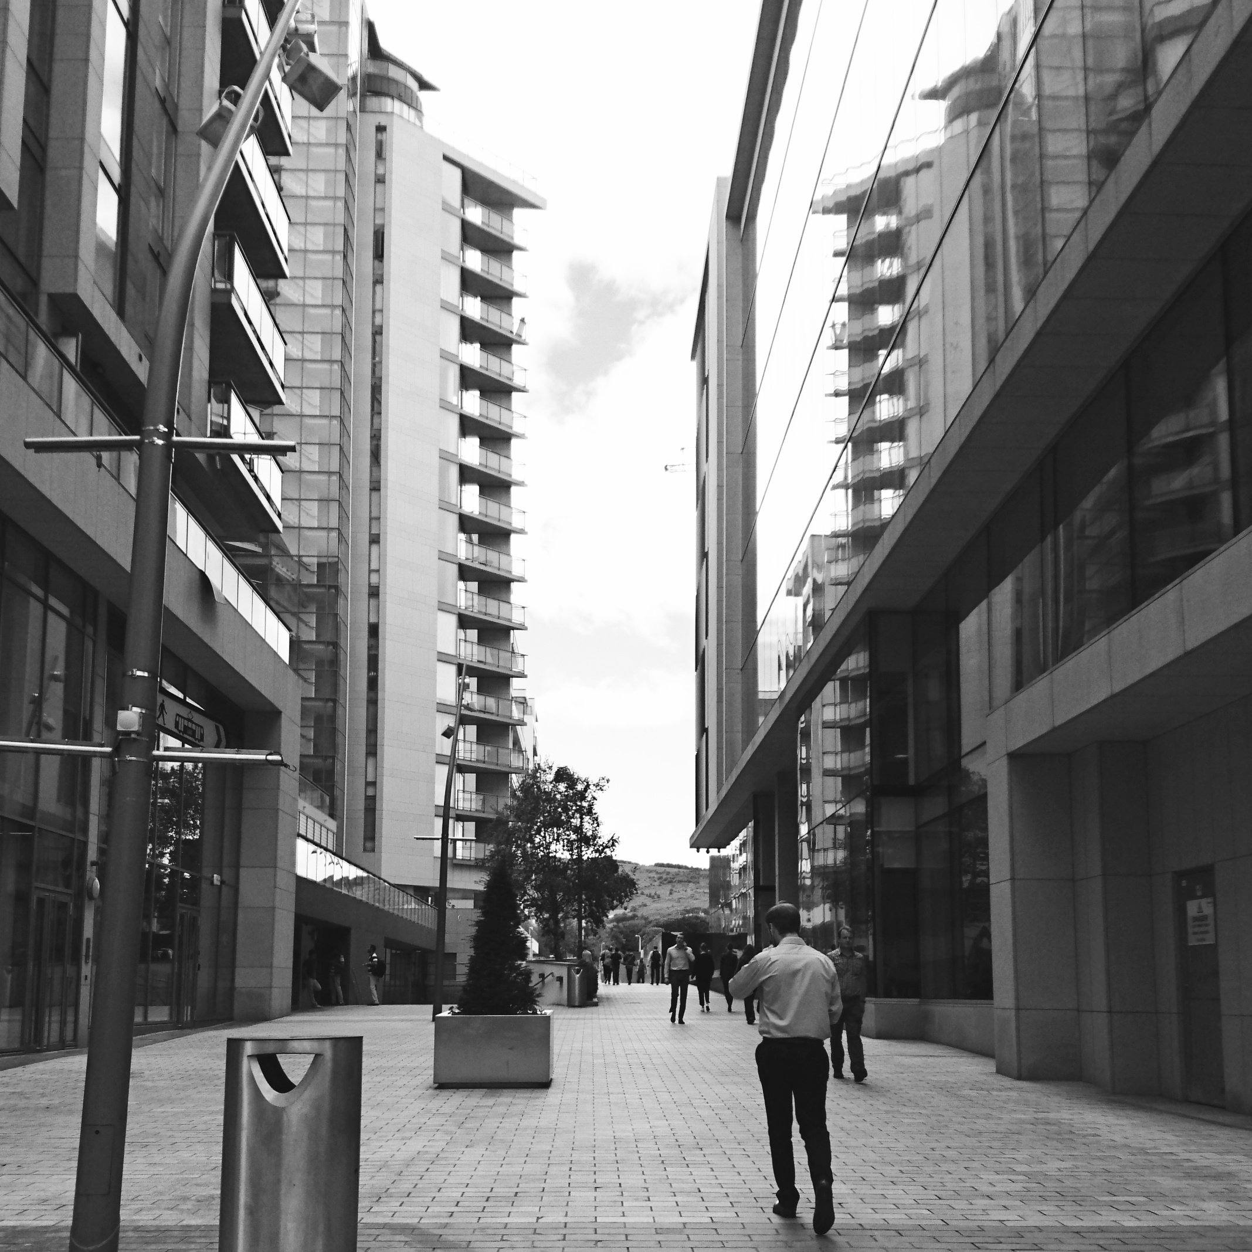



Slide 33

Thank you!
tundecsapo
Tunde Csapo

